Slide 1
Government Allowances

Slide 2
Carer Allowance
Pensions
Government Allowances
Family Tax Benefits
Youth Allowance
Others???

Slide 3
Carer Allowance
Allowance for people who provides care for an adult or dependent child because of disability, medical condition or frailty [care required on a daily basis]
Both carer and care receiver must be Australian residents.
Rate: $124.70 per fortnight
Carer supplement: $600 per annum

Slide 4
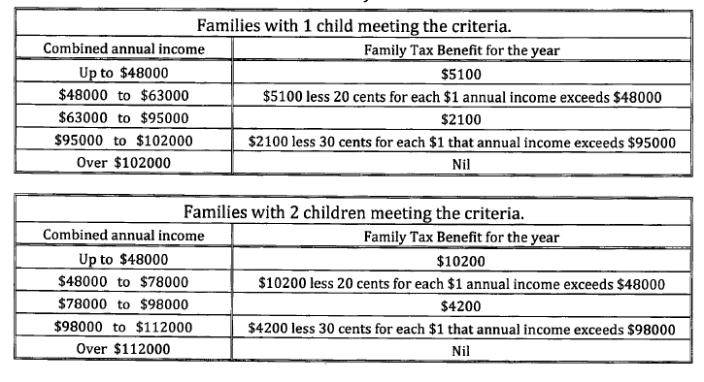
Family Tax Benefits

Slide 5
Examples
Determine the Family Tax Benefits (FTB) paid to a family of two children meeting the FTB requirements and with a combined annual family income of $65,000.
Determine the Family Tax Benefits (FTB) paid to a family of one child meeting the FTB requirements and with a combined annual family income of $105,000

